Slide 1
STUDENT AMBASSADOR FALL HACKATHON
REVOLUTIONIZING HEALTHCARE WITH AI/ML : HEALTHASSIST
ENHANCING MEDICAL DIAGNOSIS AND SERVICES

Slide 2
PROBLEM STATEMENT :
In modern healthcare, critical challenges persist, including accurate disease prediction, medication safety, accessibility to medical information, and personalized health recommendations. Our project aims to address these issues by developing an AI/ML-based web application, offering disease prediction, medication quality checks, health chatbot support, medical image analysis, and health product recommendations.
Our approach leverages Streamlit and FastAPI for user-friendly interface and Intel OneAPI libraries for enhanced performance. By doing so, we aim to provide an integrated solution that empowers users with personalized healthcare insights, improves access to medical advice, and ensures safer medication choices.

Slide 3
SOLUTION :
Our idea is a comprehensive healthcare web application, powered by AI and ML, that offers five key features:
Disease Prediction: Predicts disease probabilities based on user-entered symptoms and allows customization of AI models.
Medication Safety: Quickly assesses pill quality through image recognition.
Accessible Health Information: Provides instant medical advice through a responsive chatbot.
Medical Image Processing: Accurately detects pneumonia in X-ray images, aiding in diagnosis.
Health Product Recommendations: Personalized suggestions for health products from popular online marketplaces.

Slide 4
BUSINESS IDEA :
Our business idea centers around launching a cutting-edge healthcare web application that leverages artificial intelligence and machine learning. This platform aims to revolutionize healthcare accessibility by offering features such as disease prediction based on user symptoms and customizable AI models, quick and reliable medication safety checks through image recognition, an interactive health chatbot for instant medical advice, accurate pneumonia detection in X-ray images, and personalized health product recommendations. With a versatile revenue model, a vast potential market, and a mission to make healthcare smarter, more accessible, and safer, our business endeavors to improve health outcomes and enhance the overall healthcare experience for individuals and professionals alike.

Slide 5
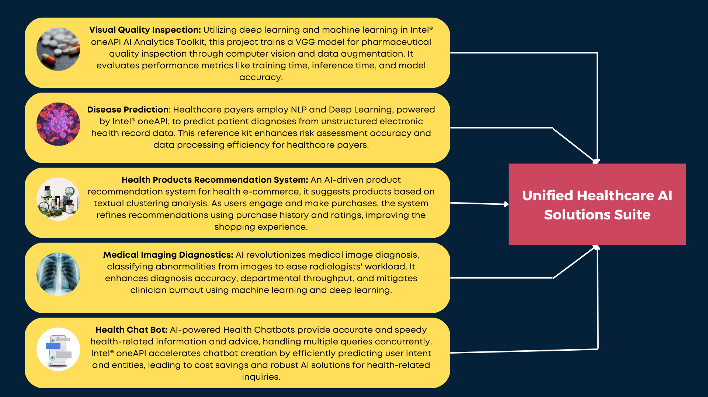

Slide 6
TECHNOLOGY STACK :
Frontend Development:
Streamlit: Our frontend is built using Streamlit, a user-friendly Python library for creating interactive web applications. Streamlit allows us to develop a visually appealing and responsive interface with ease.
Backend Development:
FastAPI: FastAPI, a modern Python web framework, powers our backend. Its asynchronous capabilities, automatic OpenAPI documentation generation, and high performance make it an ideal choice for handling data processing and API requests efficiently.
Containerization:
Docker: We employ Docker containers to modularize and package each feature separately. Docker provides scalability, ease of deployment, and ensures consistency across different environments.
AI/ML Optimization:
Intel OneAPI Libraries: To enhance the performance of our machine learning and deep learning models, we integrate Intel OneAPI libraries. These libraries leverage hardware acceleration and optimization, resulting in faster and more efficient processing.

Slide 7
FEATURES :
Disease prediction with customizable AI models based on symptoms.
Medication safety checks using image recognition.
24/7 health chatbot for medical advice and queries.
Accurate pneumonia detection in X-ray images with probability scores.
Personalized health product recommendations from online marketplaces.
User-friendly interface with Streamlit and high-performance backend with FastAPI.
Docker containers for modularity and scalability.
Intel OneAPI Libraries for optimized machine learning models.

Slide 8
INTEL ONEAPI LIBRARIES :
Intel® Optimization for PyTorch:
This library provides optimized deep learning algorithms, parallel execution capabilities, and seamless integration with Intel hardware accelerators, enabling accelerated execution of PyTorch deep learning workloads and improving training and inference performance.
Intel® Neural Compressor:
Intel Neural Compressor offers advanced techniques such as pruning, quantization, and model compression to reduce the size and complexity of neural network models without sacrificing accuracy. It enables faster training times, reduced memory usage, and improved inference performance by optimizing model parameters and structure.

Slide 9
THANK YOU

